Slide 1
Muhammad Naveed Iftikhar @navift
State-Market Relations

Slide 2






Slide 9
State or Markets
(Centralized/Binding or Voluntary/Decentralized)
State and Markets
Entrepreneurial State

Slide 10
Liberal Market Economies
Socialist Market Economies
Coordinated Market Economies
State Capitalism

Slide 11
Institutions
Regulators, Land Zoning, Dispute Resolution, Food, Buildings
Institutions
Regulators, Land Zoning, Dispute Resolution, Food, Buildings
Public Finance
State
State
Markets
SOEs
Public Procurement
Public Infrastructure

Slide 12

The Four Types of Market Structure
Number of Firms?
Many
firms
Type of Products?
One
Few
Differentiated
Identical
firm
firms
products
products
Monopolistic
Perfect
Monopoly
Oligopoly
Competition
Competition
•
Tap water
•
Auto Industry
•
Novels
•
Wheat
•
Electricity
•
Crude oil
•
Movies
•
Milk

Slide 13
Market Failure and State Intervention
Market failure caused by seller or buyer concentration
Market failure that occurs when parties other than buyers and sellers are affected by market transactions but do not participate in negotiating the transaction
Market failure that occurs because an actual market will not emerge or cannot sustain operation due to the presence of free riders who benefit t from, but do not bear the full costs of, market exchanges
Market failure caused by poor seller or buyer decisions, due to a lack of sufficient information or understanding about the product or service

Slide 14


Slide 15


Slide 16
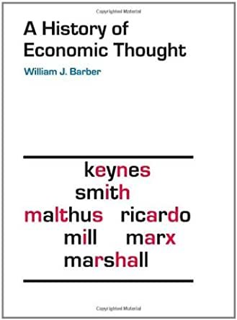

Slide 17
Development Strategies for the Next Century (Dani Rodrik)
(Market Sustaining Public Institution)
Property Rights
Regulatory Institutions
Institutions for Macroeconomic Stabilization
Institutions for Social Insurance
Institutions of Conflict Management

Slide 18
Cities, State and Markets
Zoning
Commercial Spaces
Public Places
KPIs of City Managers/Administrators
Real Estate Markets

Slide 19
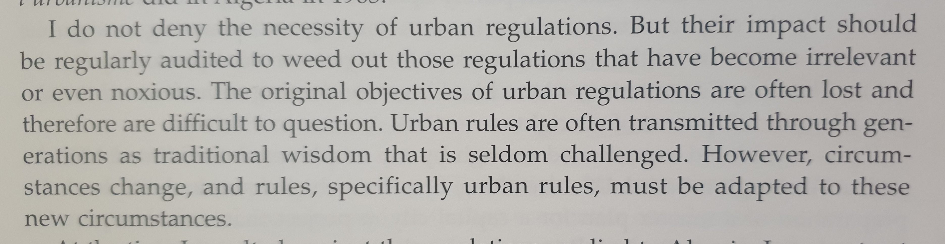

Slide 20
State and International Trade
Tariffs

Slide 21


Slide 22
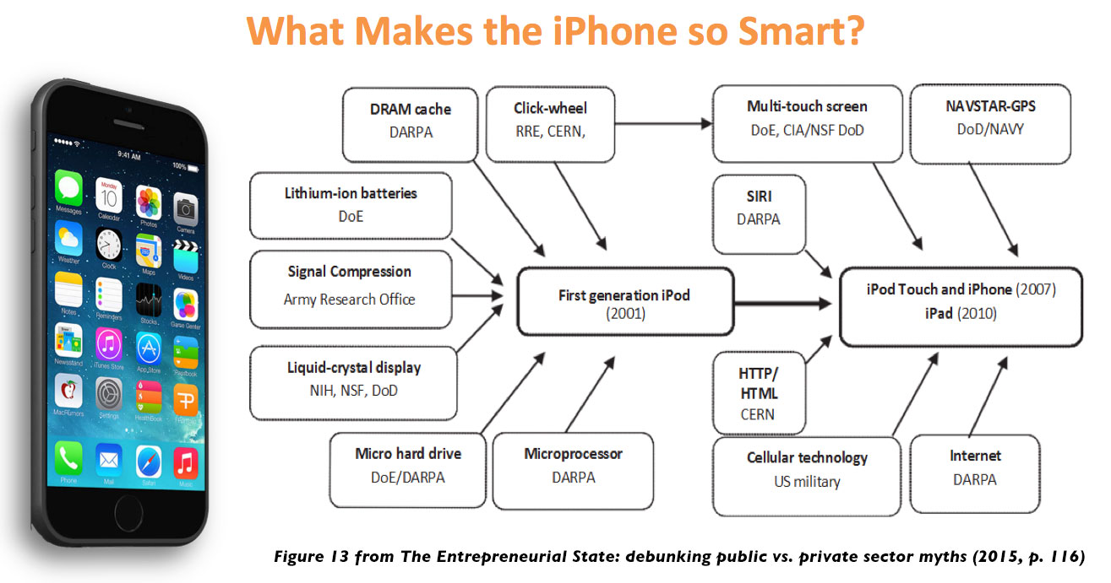

Slide 23


Slide 24
Other Support for Innovation
Venture, Credit and Capital Markets
Copy Right Protection (US Patent System Vs UK Patent System)
Dispute Resolution and Contract Enforcement

Slide 25
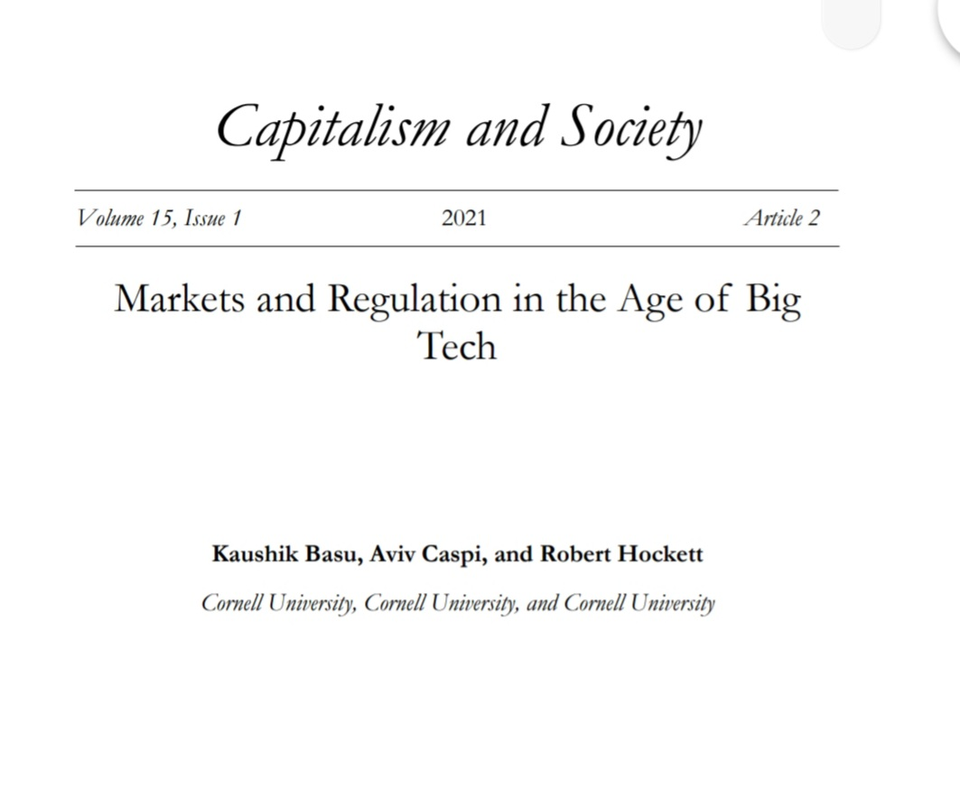

Slide 26
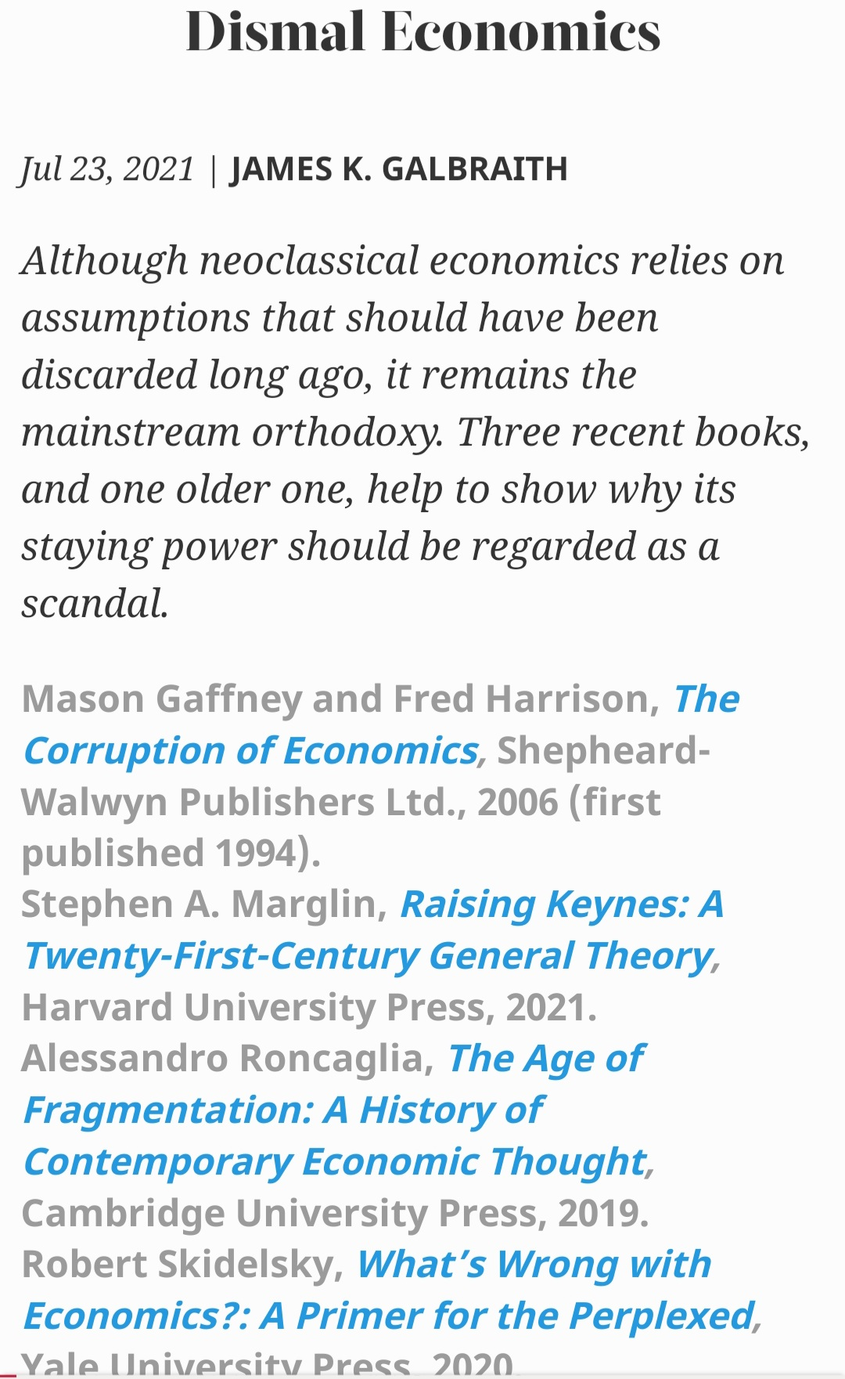
https://www.project-syndicate.org/onpoint/economics-captured-by-neoclassical-magical-thinking-by-james-k-galbraith-2021-07

Slide 27
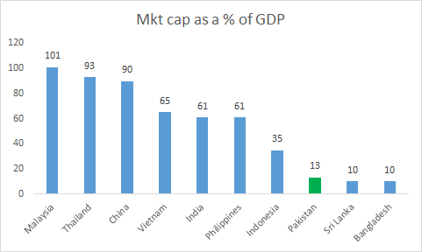
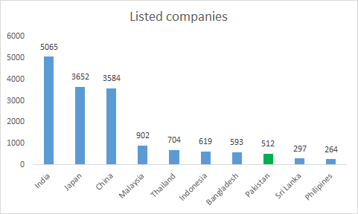
The Stock Market

Slide 28
ECC Defying Market Mechanisms
The Visible Hand of State: Understanding the working of the Economic Coordination Committee, The PRIME Institute
1. Exemptions
2. Public Procurement Contracts
3. Sovereign Guarantees
4. SOE Loans & Grants/Bail-outs
5. Subsidy & Rebates
6. Regulatory Duty/Tariffs over and above the approved budget;
7. Permissions for Capital Movement and Acquisition

Slide 29
Inquiry Reports
Sugar
Petroleum
IPPs
Wheat

Slide 30


Slide 31



Slide 32


Slide 33
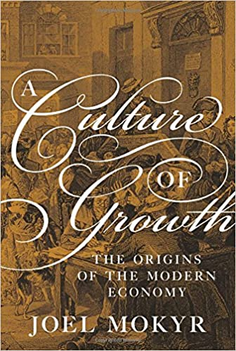

Slide 34


Slide 35

Localism e.g. Changa Pani

Slide 36


Slide 37


Slide 38


